Slide 1

Li Fi - Future Technology in Wireless Communication
By Mohammad Amir Aqeel
1701012072
B.Tech CSE-1
4th Year / 8th Semester

Slide 2
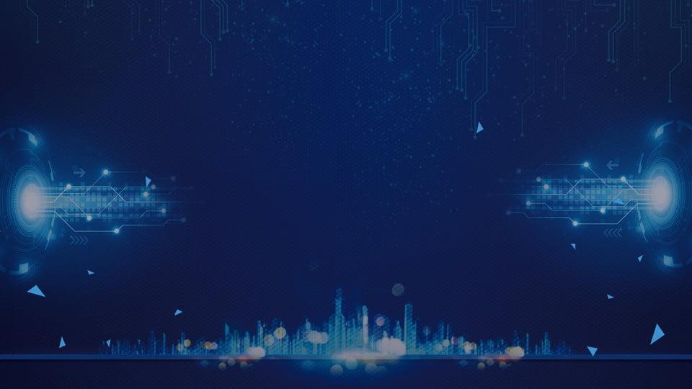
Table of Content
What is Li-Fi ?
History of Li-Fi
How it really works ?
Comparisons with other technologies
Limitations of Wi-Fi
How Li-Fi overcomes these issues
Why only VLC ?
Applications
Limitations of Li-Fi
Future Developments
Conclusion

Slide 3
What is LiFi ?

Slide 4

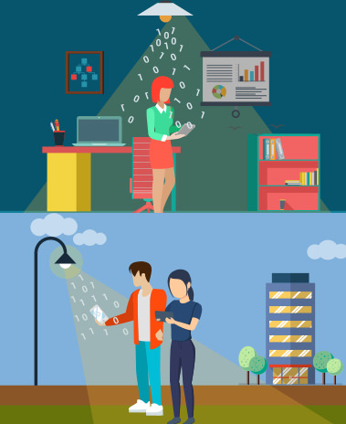
LiFi is high speed bi-directional networked and mobile communication of data using light. LiFi comprises of multiple light bulbs that form a wireless network, offering a substantially similar user experience to Wifi except using the light spectrum.
In simpler terms, LiFi is considered to be as a light-based WiFi which uses light instead of radio waves to transmit information.

Slide 5
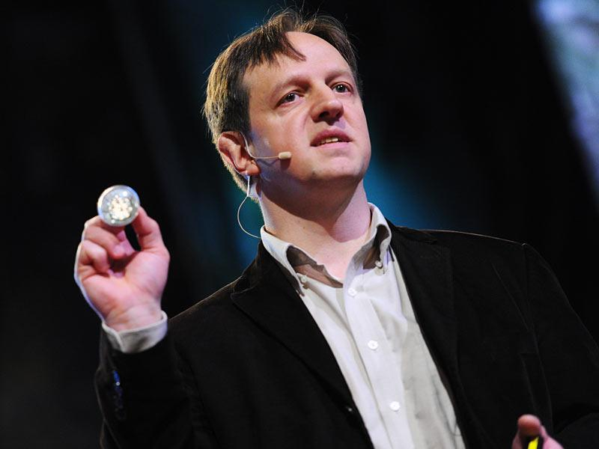
History of Li-Fi
Professor Harald Haas coined the term "Li-Fi" at his 2011 TED Global Talk where he introduced the idea of "wireless data from every light".
PureLiFi, formerly pureVLC, is an original equipment manufacturer (OEM) firm set up to commercialize Li-Fi products for integration with existing LED-lighting systems.

Slide 6
How it really Works ?

Slide 7
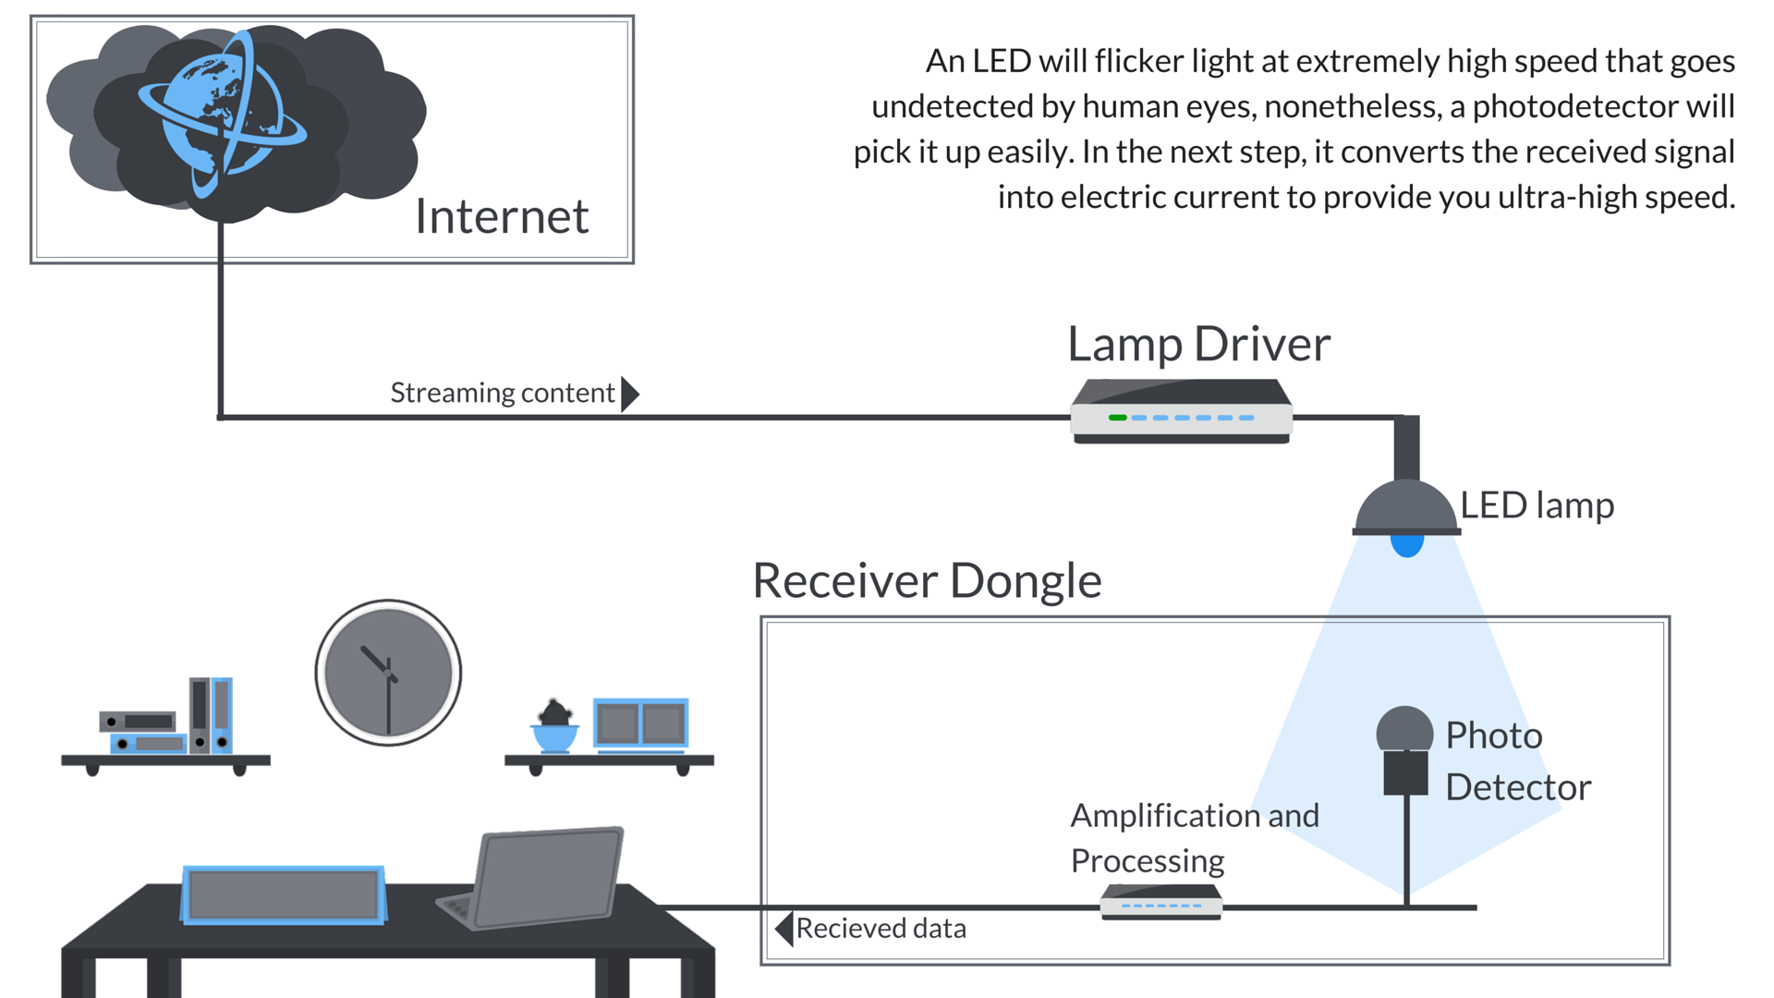

Slide 8

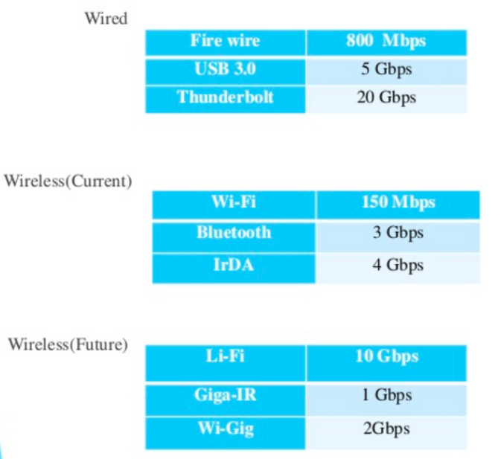
Comparisons between various technologies

Slide 9
Limitations of WiFi

Slide 10
Limited Range
Data security risks
Limitations of Wi-Fi
Interference from devices
High power consumption

Slide 11
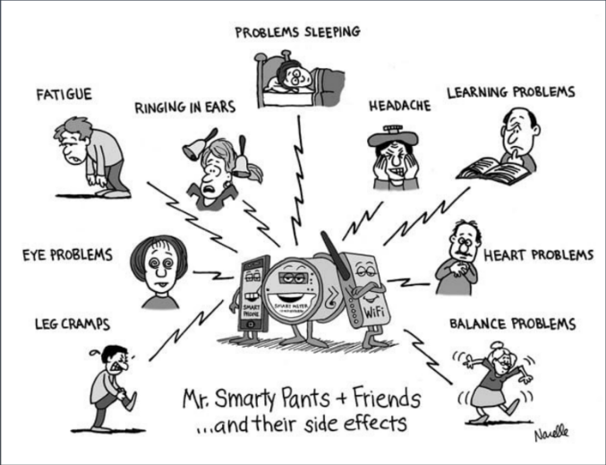

Slide 12
How LiFi overcomes these issues ?

Slide 13
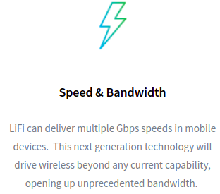
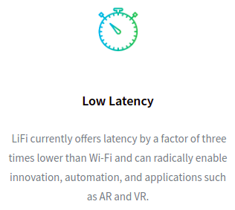
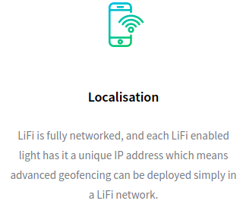
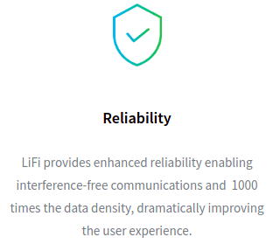
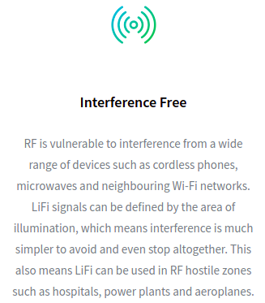
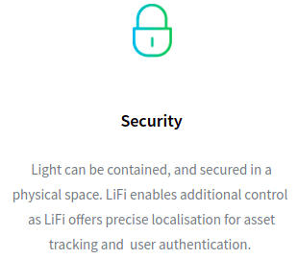

Slide 14
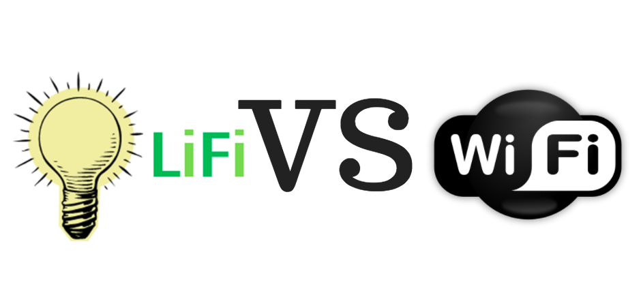
S.No | Parameters | Li-Fi | Wi-Fi
1 | Speed for data transfer | >1Gbps | 300Mbps
2 | Medium through which data transfer occurs | Visible Light | Radio Spectrum
3 | Spectrum range | 10,000 times broad spectrum than RF | Less spectrum as compared to visible light
4 | Cost | Cheaper than Wifi because free band doesn't need license | Expensive as it uses Radio frequency
5 | Network topology | Point to point | Point to point
6 | Operating frequency | 100s of Tera Hz | 2.4 GHz

Slide 15

Why only Visible Light Communication (VLC) ?

Slide 16
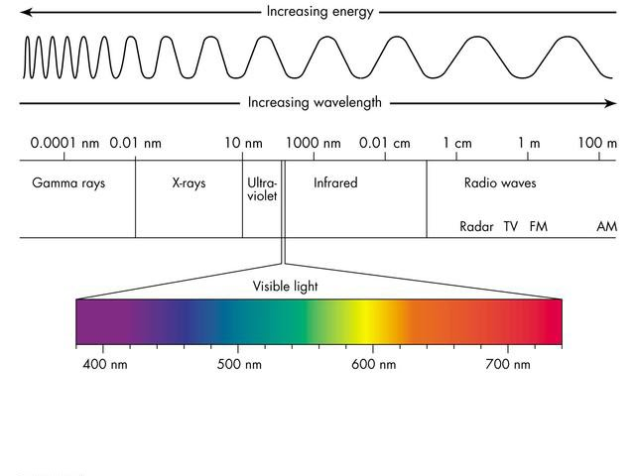

Slide 17
Can it be INFRARED waves ?
IR waves are harmful to eyes hence used at very low power.
Can it be UV rays ?
UV rays are harmful to our skin and cannot be used for long duration.
Can it be Gamma rays ?
They are radioactive and are dangerous.
Can it be X-Ray ?
Similar issues as RF.

Slide 18
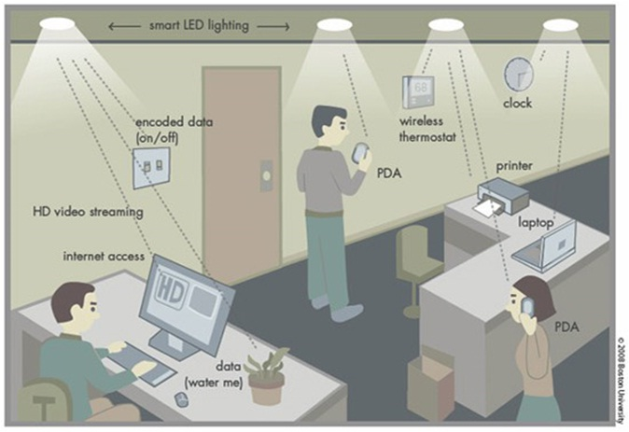

Slide 19
LiFi Applications

Slide 20
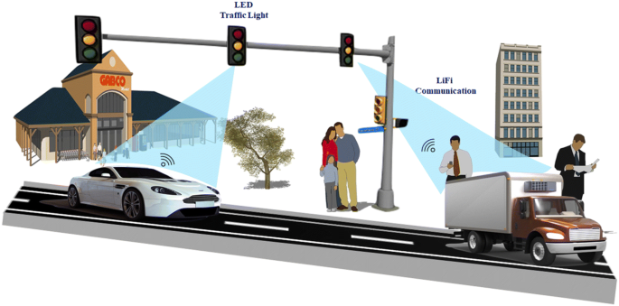
TRAFFIC SCENARIO

Slide 21
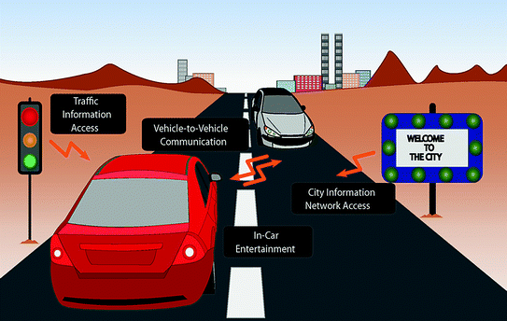
In traffic scenario, LIFI can be used to communicate with the LED lights of cars.
Cars can have LED based headlights, backlights and can communicate with each other.
This might prevent accidents, by exchanging information, when the vehicles are too close.
Using LIFI, street lights can be used to send information about the road condition to the car.
Street lamps can be used to display advertisements for nearby businesses or attractions on cellular devices as an individual passes through.
A customer walking into a store and passing through the store's front lights can show current sales and promotions on the customer's cellular device.

Slide 22
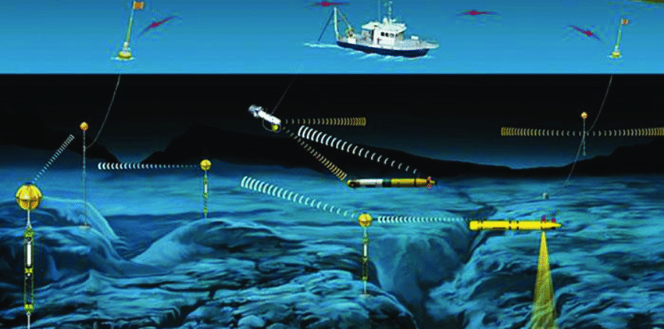
UNDERWATER SCENARIO

Slide 23
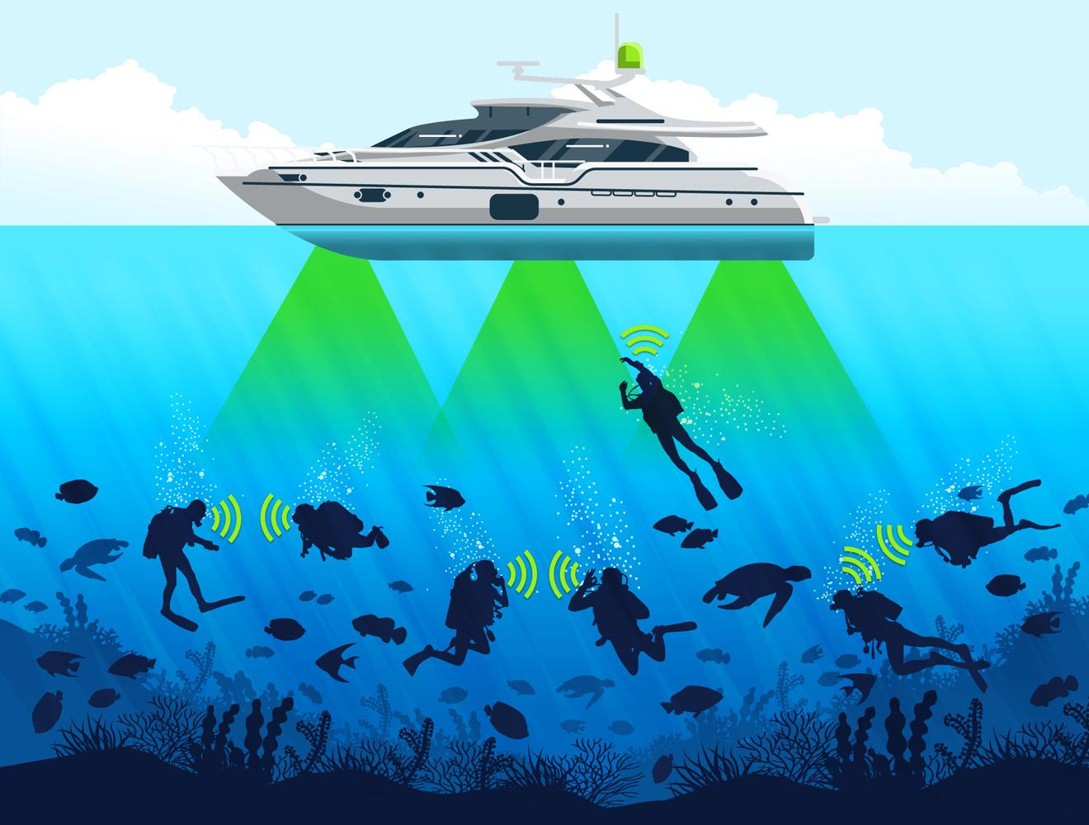
Most remotely operated underwater vehicles (ROVs) are controlled by wired connections.
The length of their cabling places a hard limit on their operational range, and other potential factors such as the cable's weight and fragility may be restrictive.
Since light can travel through water, Li-Fi based communications could offer much greater mobility.

Slide 24
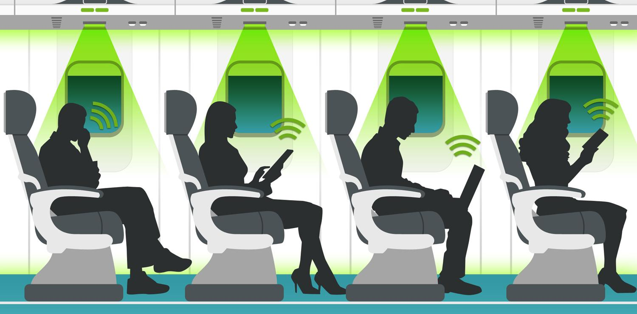
AIRPLANE SCENARIO

Slide 25
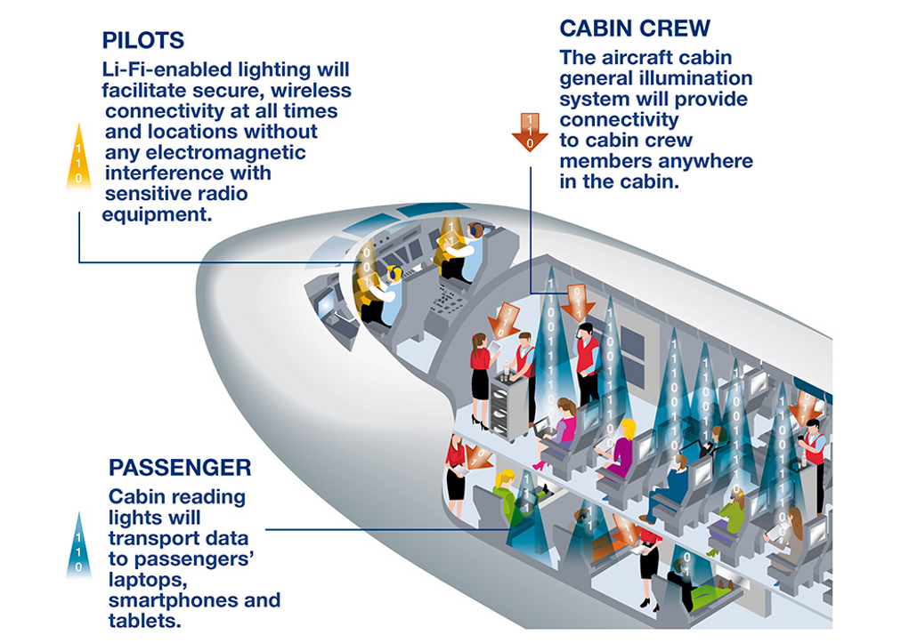
Efficient communication of data is possible in airborne environments such as a commercial passenger aircraft utilizing Li-Fi.
Using this light-based data transmission will not interfere with equipment on the aircraft that relies on radio waves such as its radar.
The whole airways communication are performed on the basis of radio waves.
Hence passengers face the problem in communication media.
This problem can be overcome by using Li-Fi, since light waves will not interfere with radio waves.

Slide 26
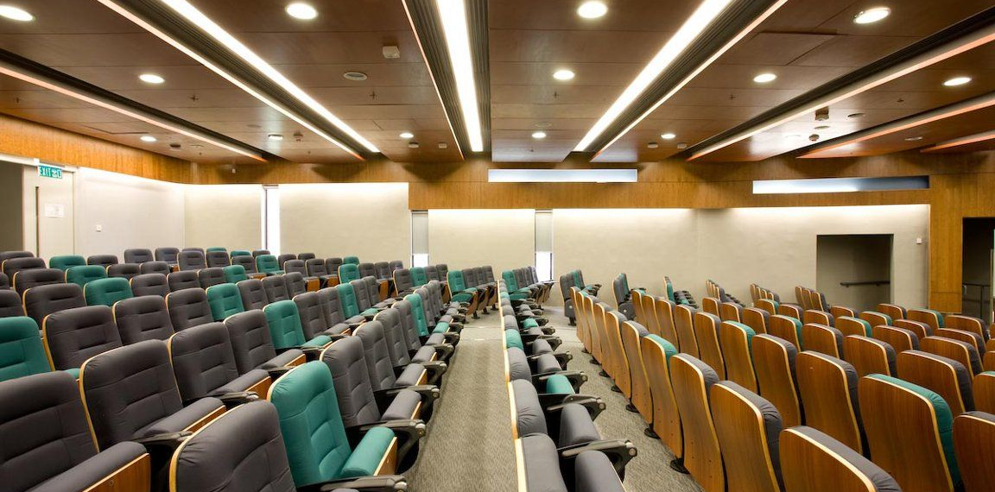
LECTURE HALL SCENARIO

Slide 27
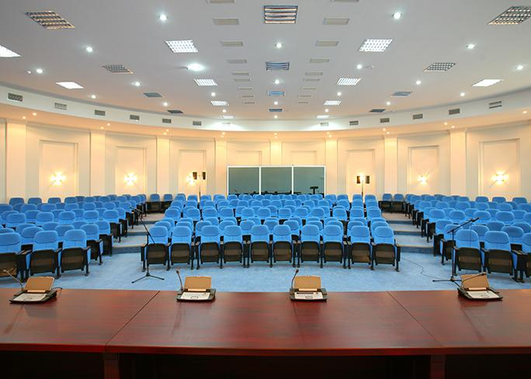
Students and teachers can be part of a more active educational community in a classroom that is Li-Fi enabled.
Students with devices such as smartphones or laptops can communicate with the teacher, or with each other, to create a more efficient learning environment.
Teachers can be able to collaborate with students to help better understand class material.
Downloading notes from teachers

Slide 28
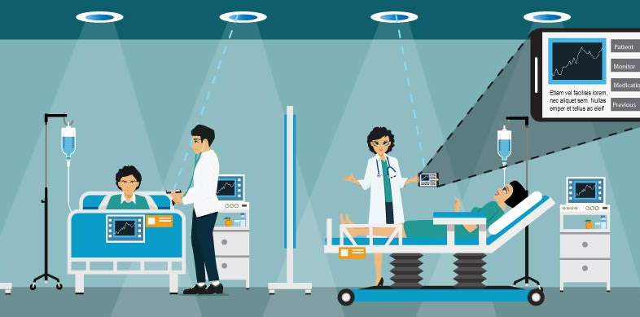
HOSPITAL SCENARIO

Slide 29
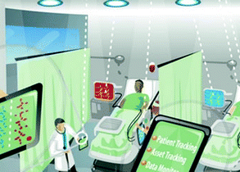
Many treatments now involve multiple individuals, Li-Fi systems could be a better system to transmit communication about the information of patients.
Besides providing a higher speed, light waves also have little effect on medical instruments.
Wireless communication can be done during the use of such medical instruments without having to worry about radio interferences hindering the efficiency of the task.

Slide 30

INDUSTRIES SCENARIO

Slide 31
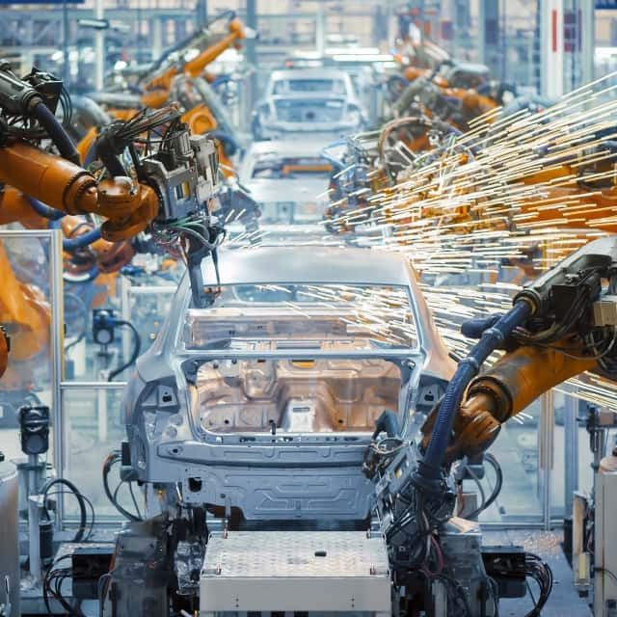
Anywhere in industrial areas data has to be transmitted, Li-Fi is capable of replacing slip rings, sliding contacts and short cables, such as Industrial Ethernet.
Due to the real time of Li-Fi (which is often required for automation processes) it is also an alternative to common industrial Wireless LAN standards.
Fraunhofer IPMS, a research organisation in Germany states that they have developed a component which is very appropriate for industrial applications with time sensitive data transmission.

Slide 32
Limitations of LiFi

Slide 33
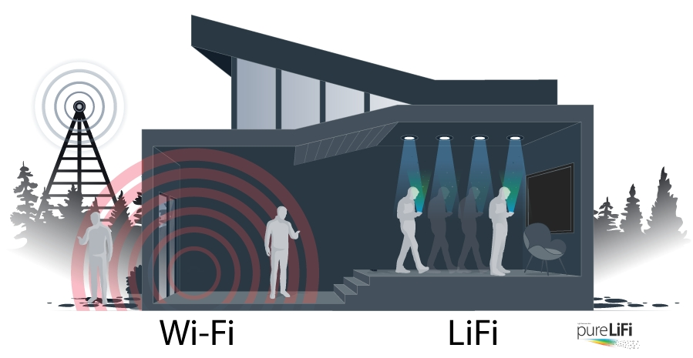
Li-Fi doesn't work in the dark.
Li-Fi has a big drawback compared to Wi-Fi, unlike Wi-Fi we cannot move to other rooms unless there are wired bulbs too.
Light can’t pass through objects.
Interference from external sources like sunlight, normal bulbs, and opaque materials in the path of transmission will course interruption in the communication.
High installation cost of the VLC systems.
A major challenge facing Li-Fi is how the receiving device will transmit back to transmitter.

Slide 34
Future Developments

Slide 35
Efficient alternative to radio based wireless.
Li-Fi is an emerging technology which is quick and reliable.
Air waves are clogged so let's use light waves.
Hence, let's proceed to Li-Fi for a brighter, cheaper and greener future.

Slide 36
CONCLUSION
The possibilities are numerous and can be explored further. If this technology can be put into practical use, every bulb can be used something like a Wifi hotspot to transmit wireless data and we will proceed toward the cleaner, greener, safer and brighter future.

Slide 37
Thank you !

